Slide 1
Database Management Systems
By:
Dr. Neha Nandal
Computer Science and Engineering

Slide 2
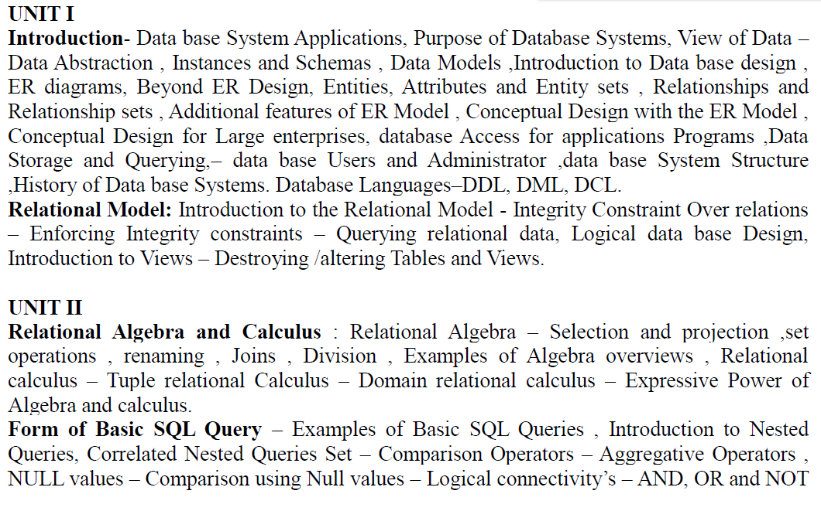
DATABASE MANAGEMENT SYSTEMS

Slide 3
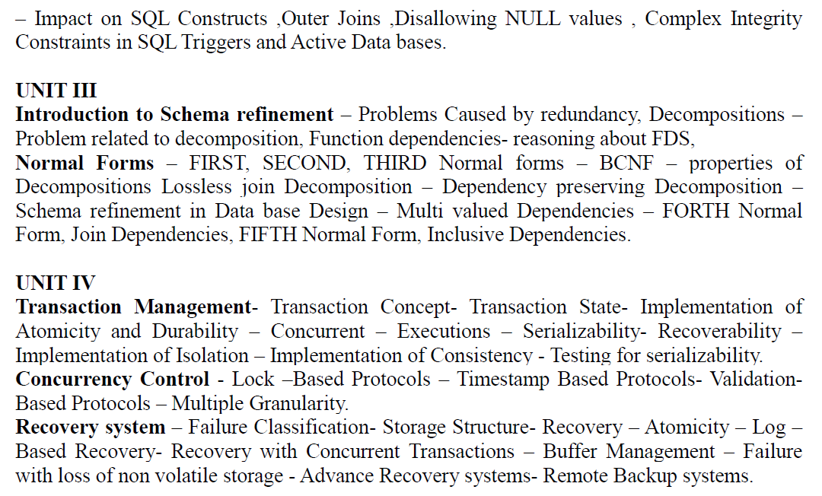
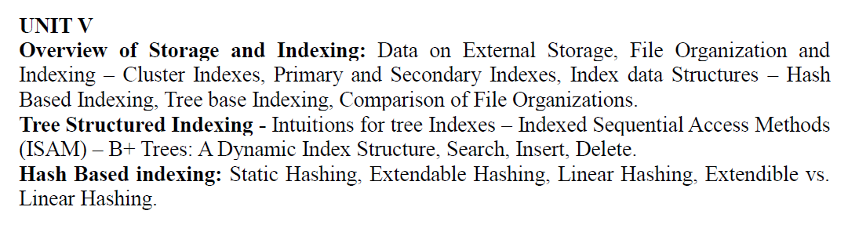

Slide 4
TEXT BOOKS:
1. Data base System Concepts, Silberschatz, Korth, McGraw hill, Sixth Edition.(All UNITS except III th)
2. Data base Management Systems, Raghurama Krishnan, Johannes Gehrke, TATA McGrawHill 3rd Edition.

Slide 5
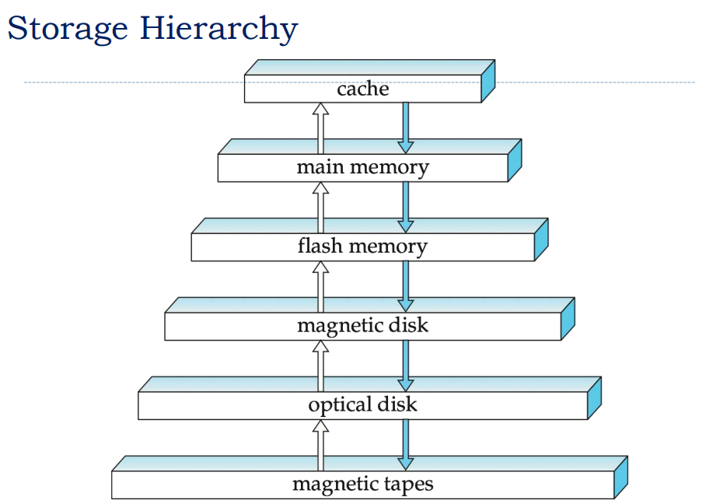

Slide 6
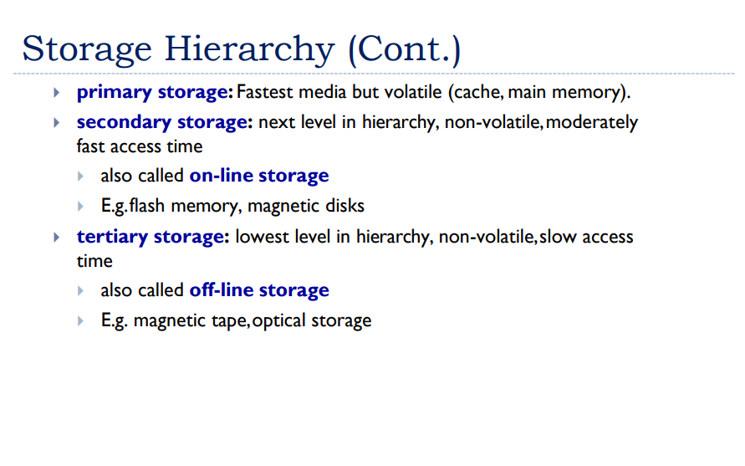

Slide 7
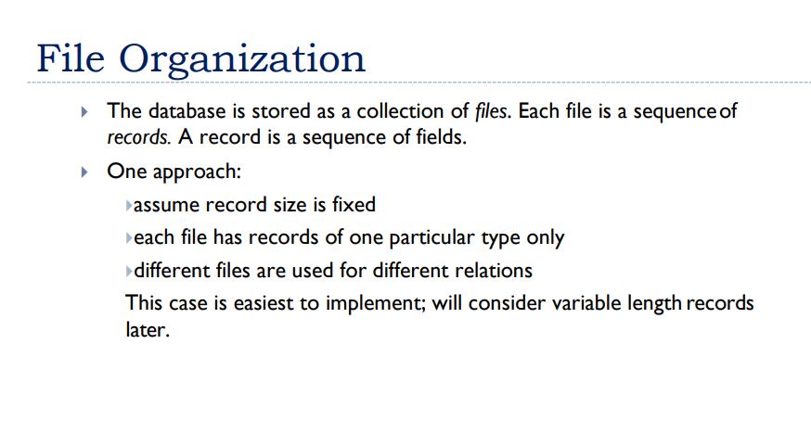

Slide 8
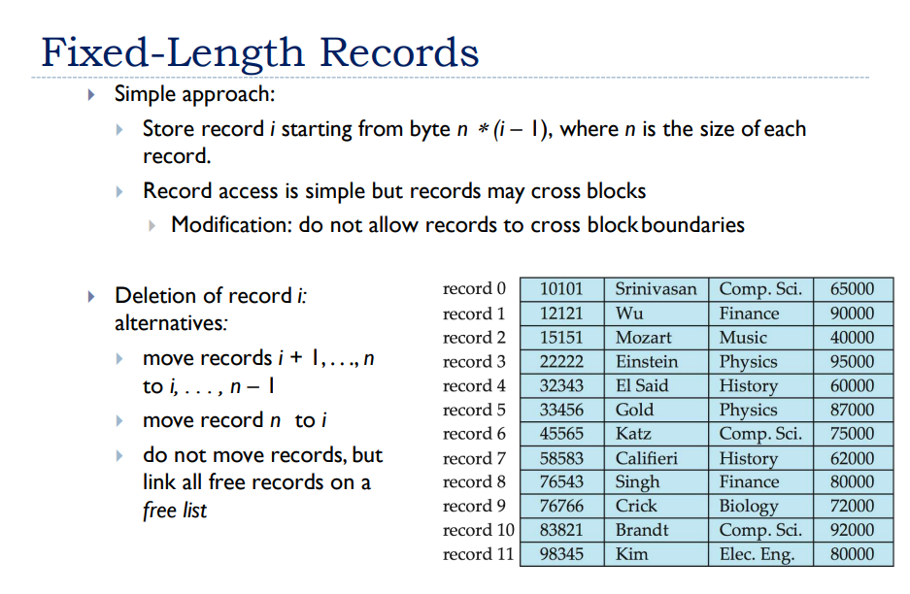

Slide 9
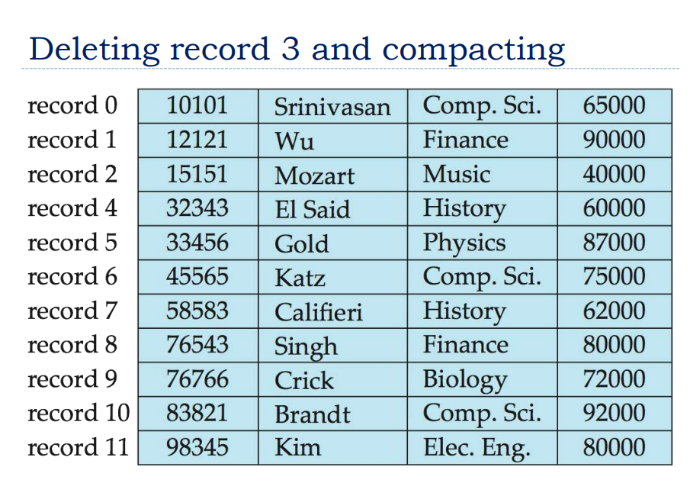

Slide 10
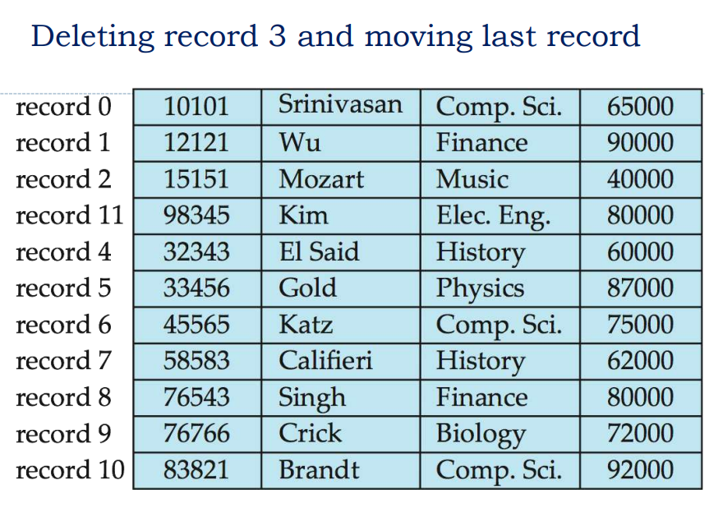

Slide 11
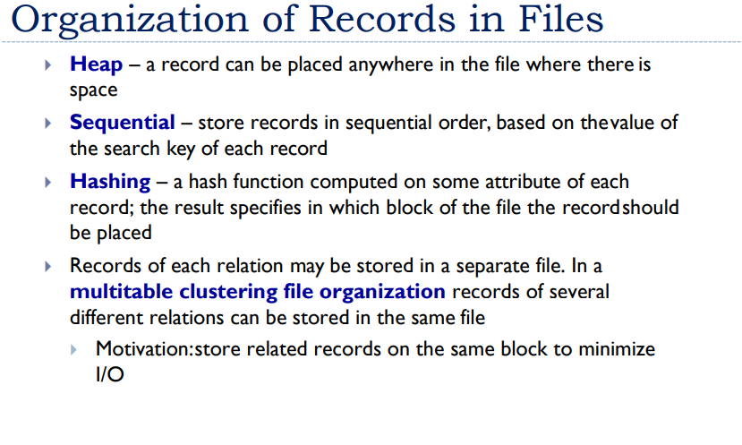

Slide 12
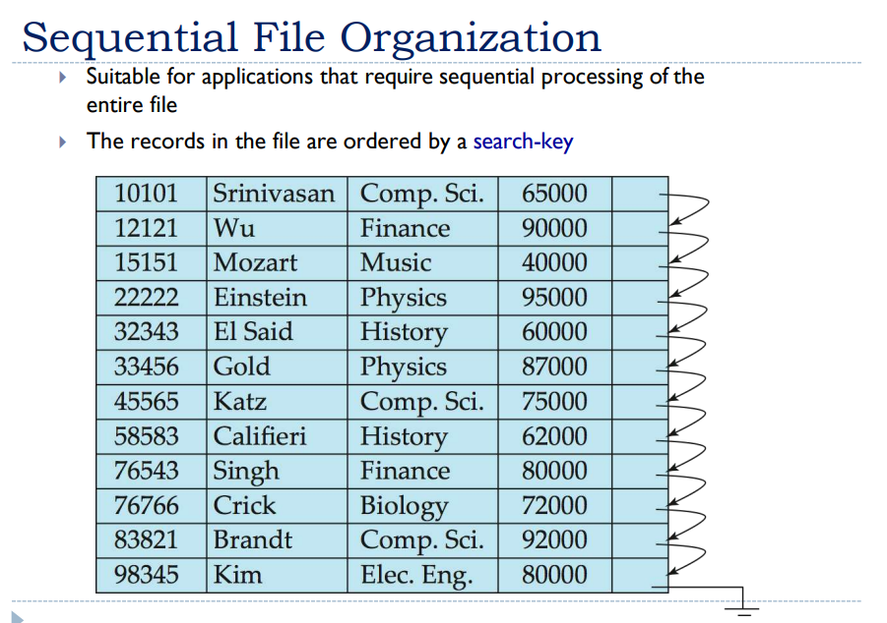

Slide 13
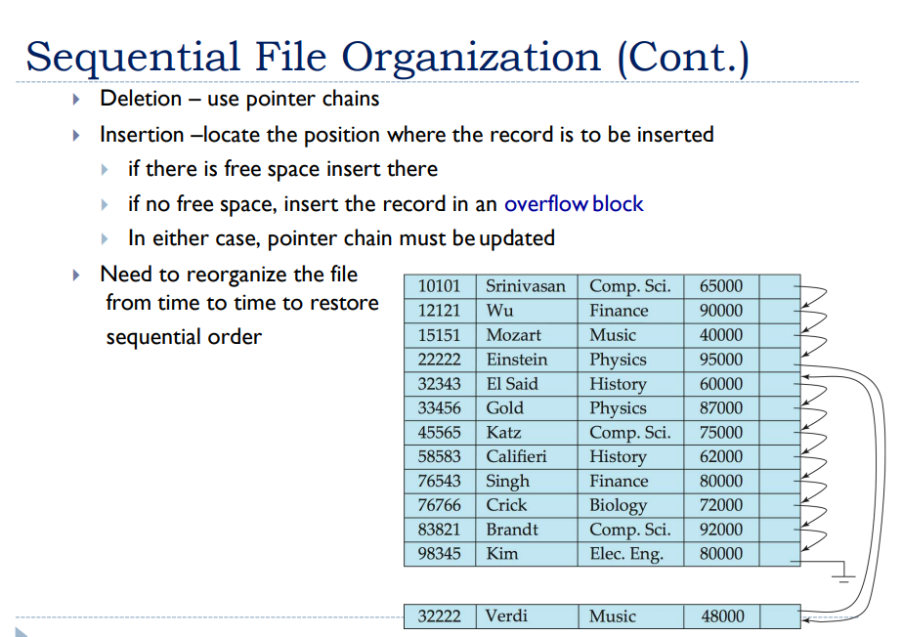

Slide 14
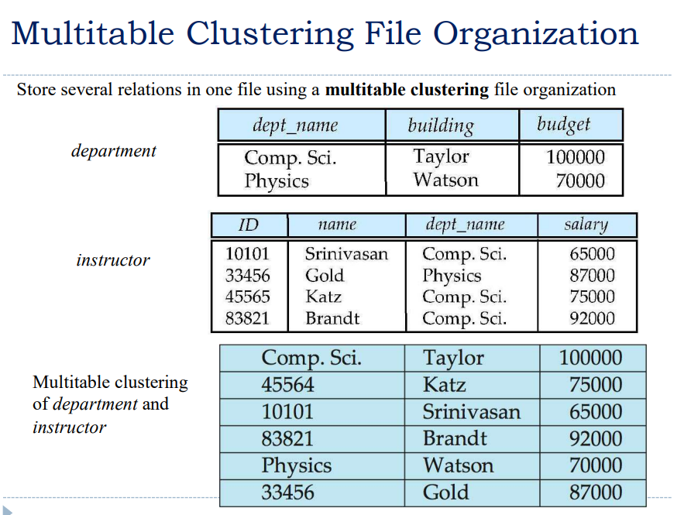

Slide 15
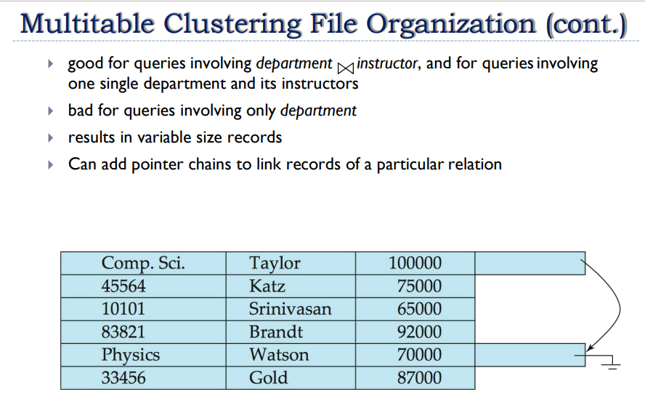

Slide 16
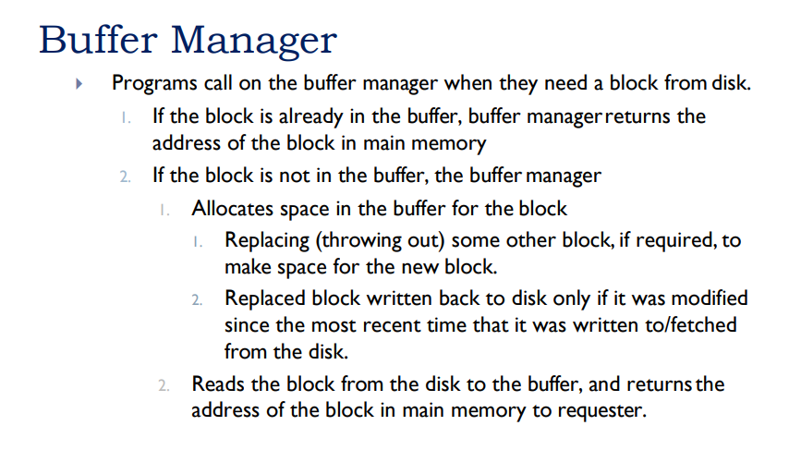

Slide 17
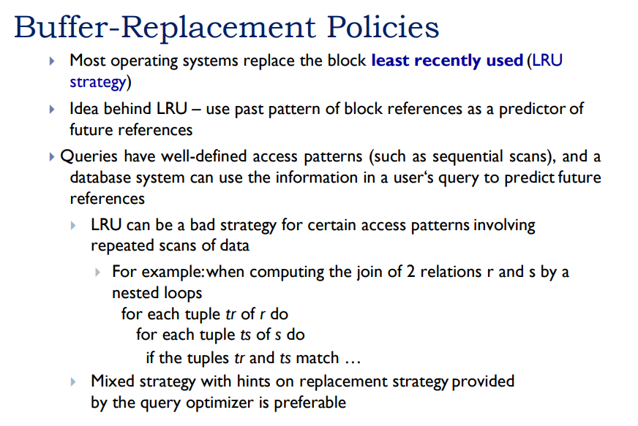

Slide 18
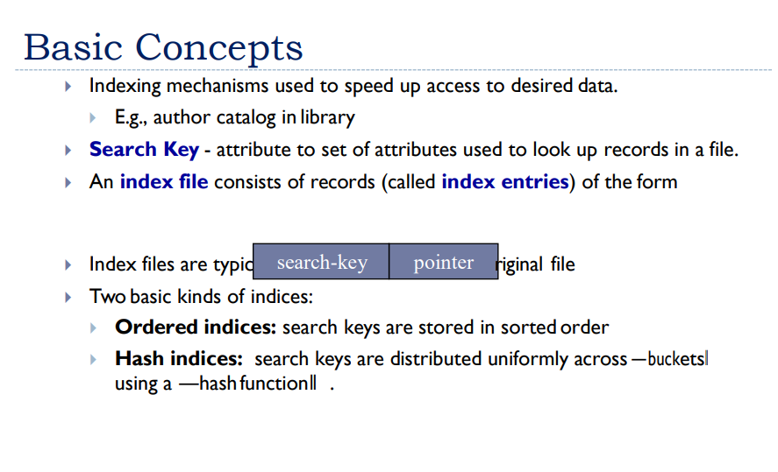
INDEXING AND HASHING

Slide 19
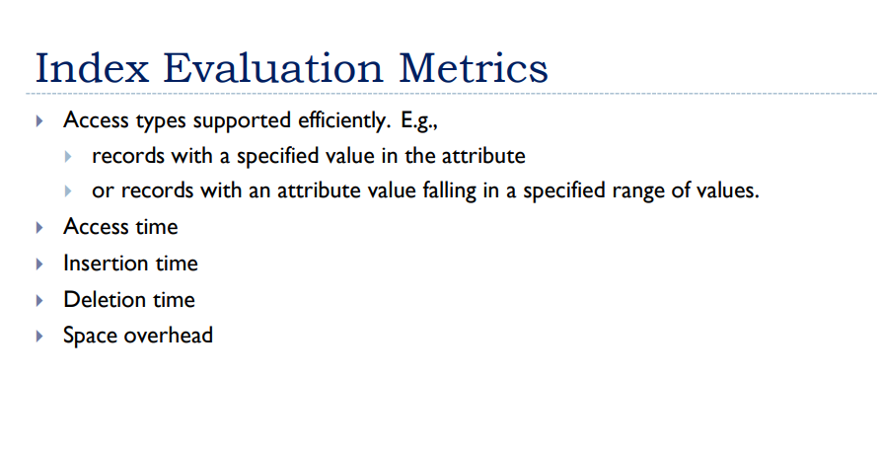

Slide 20
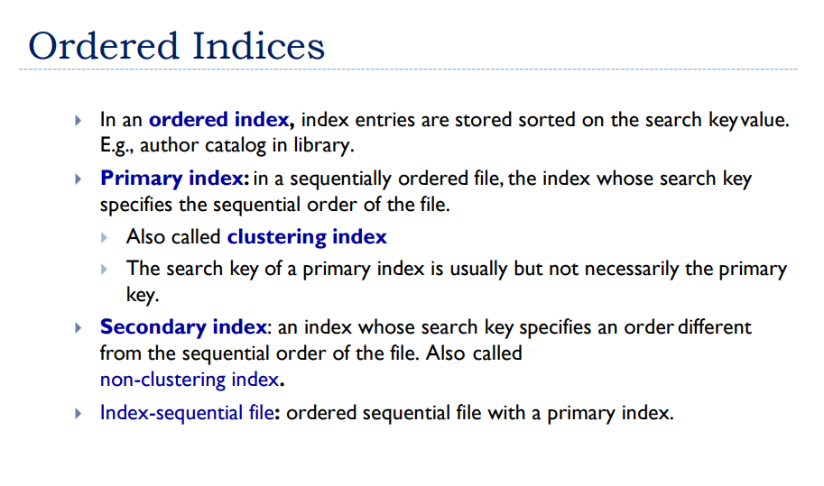

Slide 21
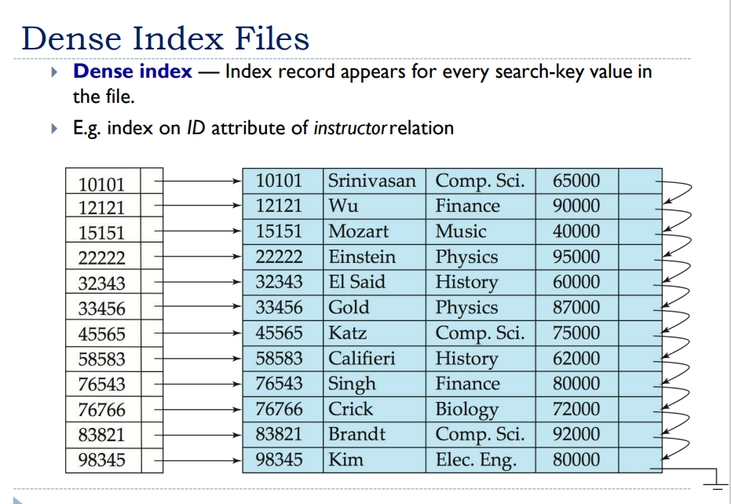

Slide 22
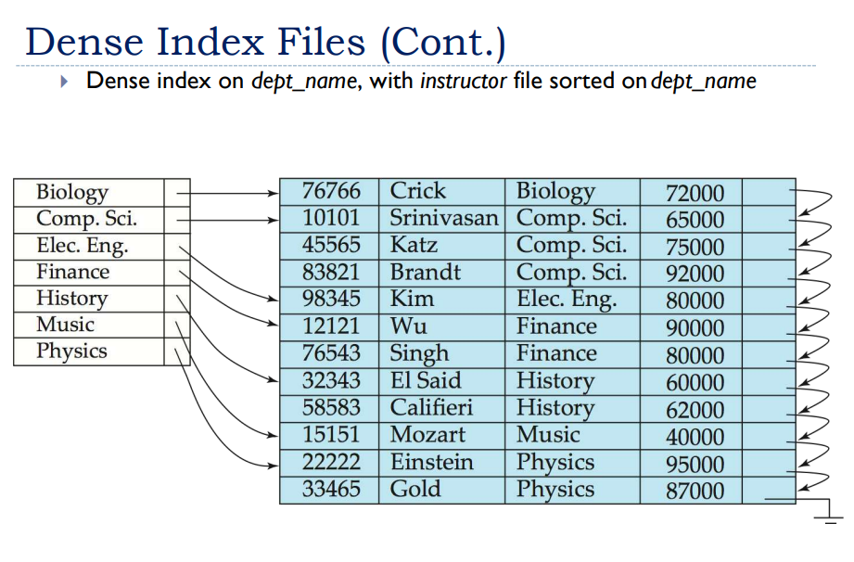

Slide 23
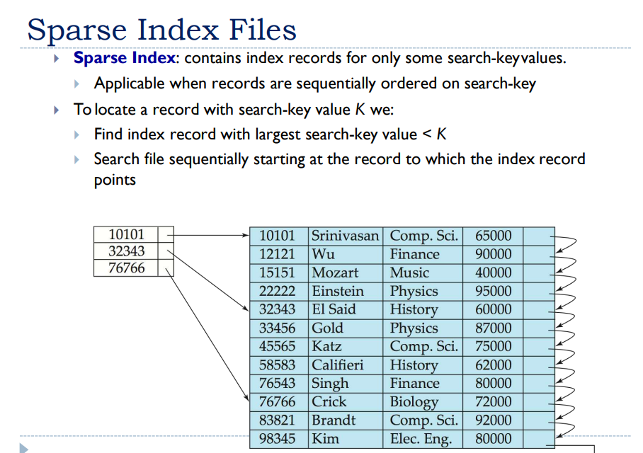

Slide 24
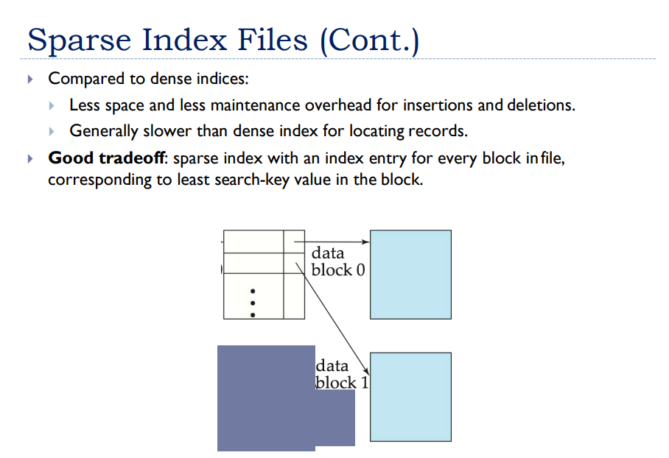

Slide 25
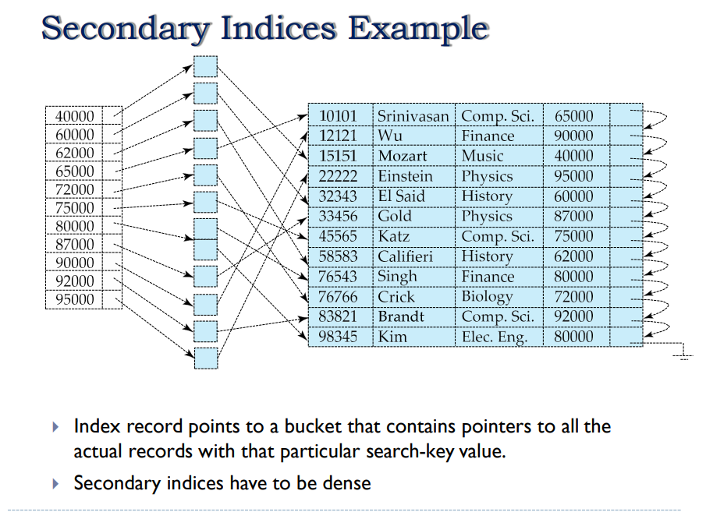

Slide 26
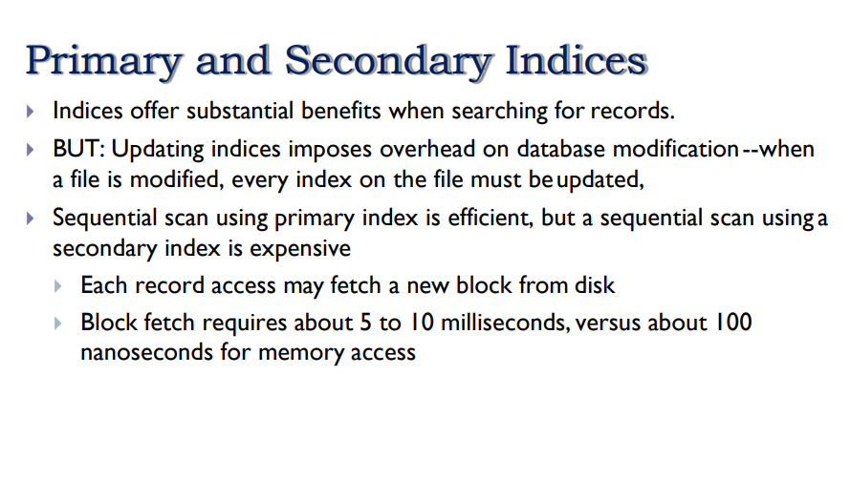

Slide 27
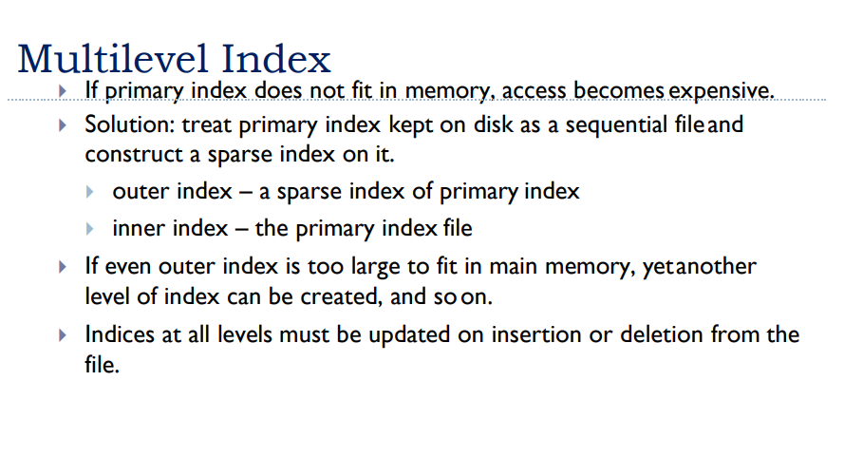

Slide 28
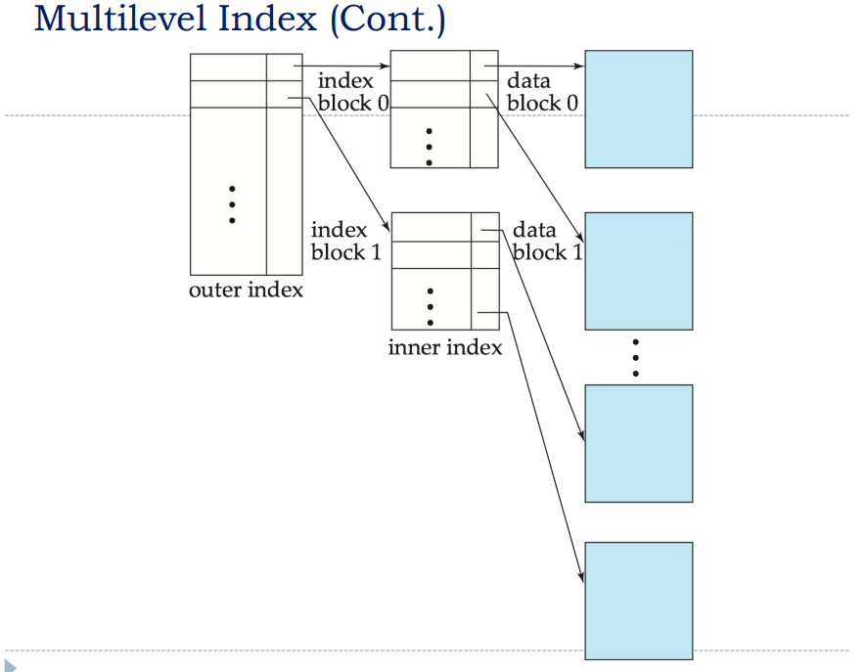

Slide 29
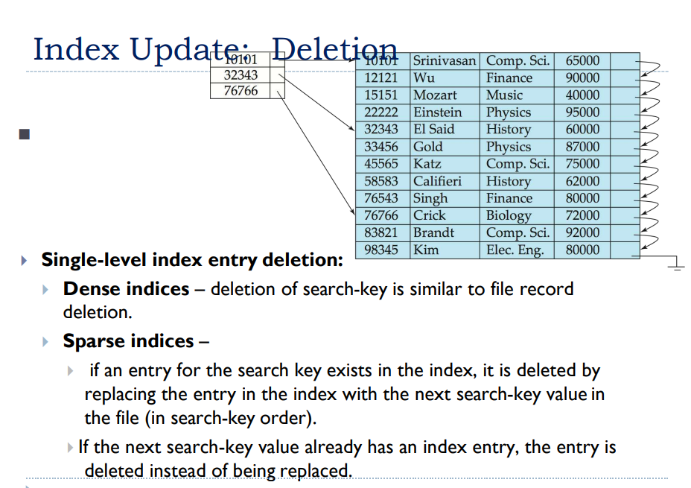

Slide 30
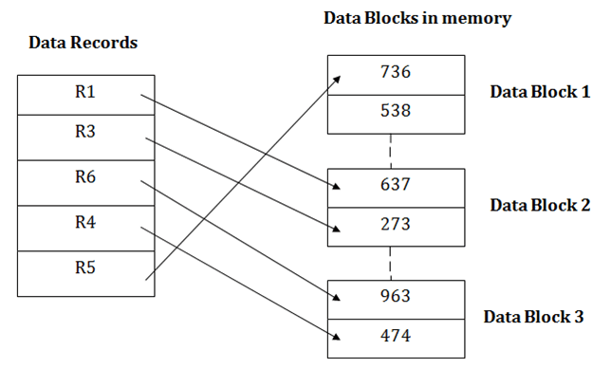
Heap file organization
It is the simplest and most basic type of organization. It works with data blocks. In heap file organization, the records are inserted at the file's end. When the records are inserted, it doesn't require the sorting and ordering of records.
When the data block is full, the new record is stored in some other block. This new data block need not to be the very next data block, but it can select any data block in the memory to store new records. The heap file is also known as an unordered file.
In the file, every record has a unique id, and every page in a file is of the same size. It is the DBMS responsibility to store and manage the new records.

Slide 31
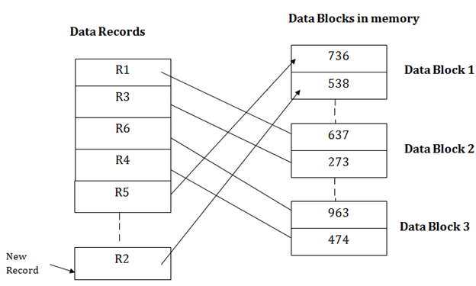
Insertion of a new record
Suppose we have five records R1, R3, R6, R4 and R5 in a heap and suppose we want to insert a new record R2 in a heap. If the data block 3 is full then it will be inserted in any of the database selected by the DBMS, let's say data block 1.
If we want to search, update or delete the data in heap file organization, then we need to traverse the data from staring of the file till we get the requested record.
If the database is very large then searching, updating or deleting of record will be time-consuming because there is no sorting or ordering of records. In the heap file organization, we need to check all the data until we get the requested record.

Slide 32
Pros of Heap file organization
It is a very good method of file organization for bulk insertion. If there is a large number of data which needs to load into the database at a time, then this method is best suited.
In case of a small database, fetching and retrieving of records is faster than the sequential record.
Cons of Heap file organization
This method is inefficient for the large database because it takes time to search or modify the record.
This method is inefficient for large databases.

Slide 33
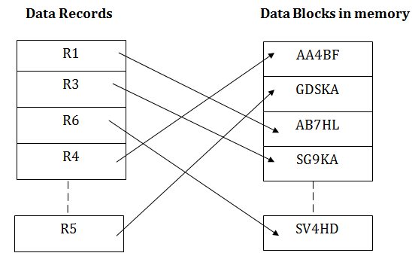
Hash File Organization
Hash File Organization uses the computation of hash function on some fields of the records. The hash function's output determines the location of disk block where the records are to be placed.
When a record has to be received using the hash key columns, then the address is generated, and the whole record is retrieved using that address. In the same way, when a new record has to be inserted, then the address is generated using the hash key and record is directly inserted. The same process is applied in the case of delete and update.
In this method, there is no effort for searching and sorting the entire file. In this method, each record will be stored randomly in the memory.

Slide 34
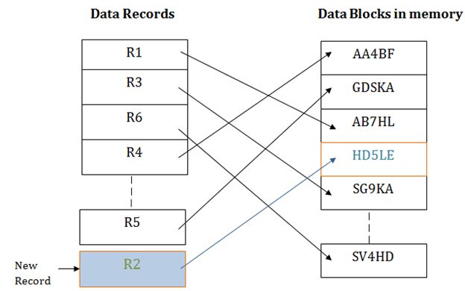

Slide 35
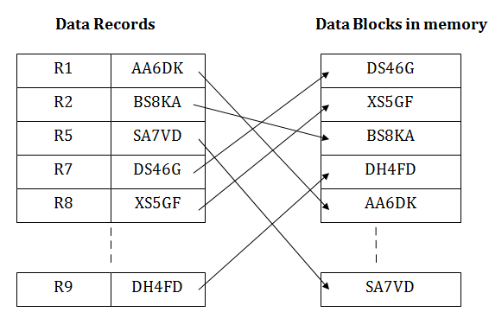
Indexed sequential access method (ISAM)
ISAM method is an advanced sequential file organization. In this method, records are stored in the file using the primary key. An index value is generated for each primary key and mapped with the record. This index contains the address of the record in the file.
If any record has to be retrieved based on its index value, then the address of the data block is fetched and the record is retrieved from the memory.

Slide 36
In this method, each record has the address of its data block, searching a record in a huge database is quick and easy.
This method supports range retrieval and partial retrieval of records. Since the index is based on the primary key values, we can retrieve the data for the given range of value. In the same way, the partial value can also be easily searched, i.e., the student name starting with 'JA' can be easily searched.
Cons of ISAM
This method requires extra space in the disk to store the index value.
When the new records are inserted, then these files have to be reconstructed to maintain the sequence.
When the record is deleted, then the space used by it needs to be released. Otherwise, the performance of the database will slow down.

Slide 37
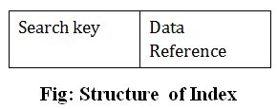
Indexing in DBMS
Indexing is used to optimize the performance of a database by minimizing the number of disk accesses required when a query is processed.
The index is a type of data structure. It is used to locate and access the data in a database table quickly.
Index structure:
Indexes can be created using some database columns.
The first column of the database is the search key that contains a copy of the primary key or candidate key of the table. The values of the primary key are stored in sorted order so that the corresponding data can be accessed easily.
The second column of the database is the data reference. It contains a set of pointers holding the address of the disk block where the value of the particular key can be found.

Slide 38
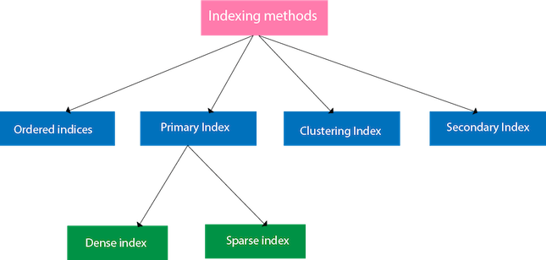
Indexing Methods

Slide 39
Ordered indices
The indices are usually sorted to make searching faster. The indices which are sorted are known as ordered indices.
Example: Suppose we have an employee table with thousands of record and each of which is 10 bytes long. If their IDs start with 1, 2, 3....and so on and we have to search student with ID-543.
In the case of a database with no index, we have to search the disk block from starting till it reaches 543. The DBMS will read the record after reading 543*10=5430 bytes.
In the case of an index, we will search using indexes and the DBMS will read the record after reading 542*2= 1084 bytes which are very less compared to the previous case.

Slide 40
Primary Index
If the index is created on the basis of the primary key of the table, then it is known as primary indexing. These primary keys are unique to each record and contain 1:1 relation between the records.
As primary keys are stored in sorted order, the performance of the searching operation is quite efficient.
The primary index can be classified into two types: Dense index and Sparse index.

Slide 41
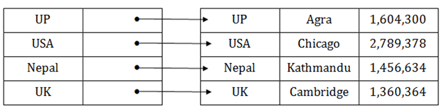
Dense index
The dense index contains an index record for every search key value in the data file. It makes searching faster.
In this, the number of records in the index table is same as the number of records in the main table.
It needs more space to store index record itself. The index records have the search key and a pointer to the actual record on the disk.

Slide 42
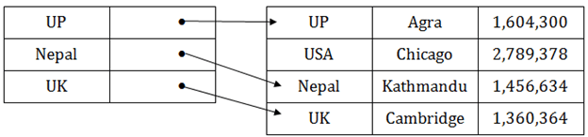
Sparse index
In the data file, index record appears only for a few items. Each item points to a block.
In this, instead of pointing to each record in the main table, the index points to the records in the main table in a gap.

Slide 43
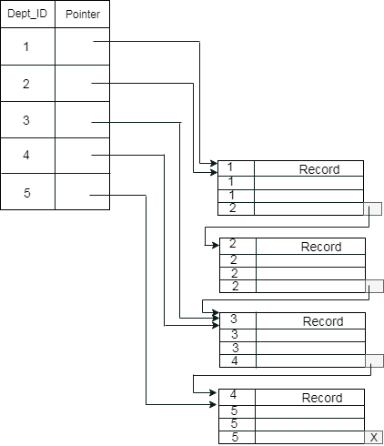
Clustering Index
A clustered index can be defined as an ordered data file. Sometimes the index is created on non-primary key columns which may not be unique for each record.
In this case, to identify the record faster, we will group two or more columns to get the unique value and create index out of them. This method is called a clustering index.
The records which have similar characteristics are grouped, and indexes are created for these group.
Example: suppose a company contains several employees in each department. Suppose we use a clustering index, where all employees which belong to the same Dept_ID are considered within a single cluster, and index pointers point to the cluster as a whole. Here Dept_Id is a non-unique key.
This schema is little confusing because one disk block is shared by records which belong to the different cluster. If we use separate disk block for separate clusters, then it is called better technique.

Slide 44
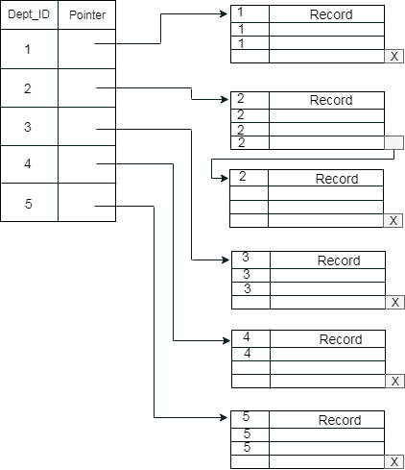

Slide 45
Secondary Index
In the sparse indexing, as the size of the table grows, the size of mapping also grows. These mappings are usually kept in the primary memory so that address fetch should be faster. Then the secondary memory searches the actual data based on the address got from mapping. If the mapping size grows then fetching the address itself becomes slower. In this case, the sparse index will not be efficient. To overcome this problem, secondary indexing is introduced.
In secondary indexing, to reduce the size of mapping, another level of indexing is introduced. In this method, the huge range for the columns is selected initially so that the mapping size of the first level becomes small. Then each range is further divided into smaller ranges. The mapping of the first level is stored in the primary memory, so that address fetch is faster. The mapping of the second level and actual data are stored in the secondary memory (hard disk).

Slide 46
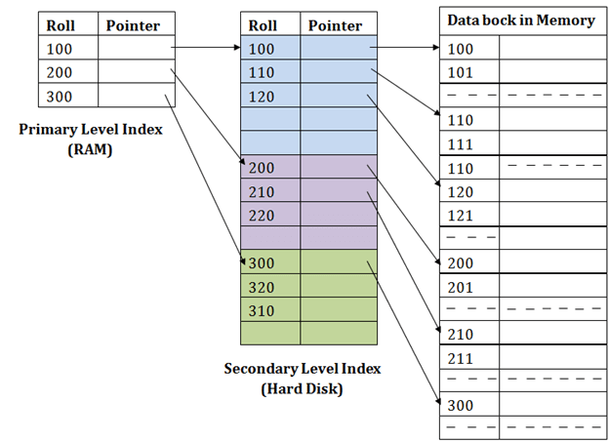

Slide 47
For example:
If you want to find the record of roll 111 in the diagram, then it will search the highest entry which is smaller than or equal to 111 in the first level index. It will get 100 at this level.
Then in the second index level, again it does max (111) <= 111 and gets 110. Now using the address 110, it goes to the data block and starts searching each record till it gets 111.
This is how a search is performed in this method. Inserting, updating or deleting is also done in the same manner.

Slide 48
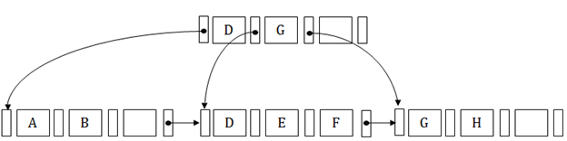
B+ tree
The B+ tree is a balanced binary search tree. It follows a multi-level index format.
In the B+ tree, leaf nodes denote actual data pointers. B+ tree ensures that all leaf nodes remain at the same height.
In the B+ tree, the leaf nodes are linked using a link list. Therefore, a B+ tree can support random access as well as sequential access.
Structure of B+ Tree
In the B+ tree, every leaf node is at equal distance from the root node. The B+ tree is of the order n where n is fixed for every B+ tree.
It contains an internal node and leaf node.

Slide 49
Internal node
An internal node of the B+ tree can contain at least n/2 record pointers except the root node.
At most, an internal node of the tree contains n pointers.
Leaf node
The leaf node of the B+ tree can contain at least n/2 record pointers and n/2 key values.
At most, a leaf node contains n record pointer and n key values.
Every leaf node of the B+ tree contains one block pointer P to point to next leaf node.

Slide 50
Checkpoint
The checkpoint is a type of mechanism where all the previous logs are removed from the system and permanently stored in the storage disk.
The checkpoint is like a bookmark. While the execution of the transaction, such checkpoints are marked, and the transaction is executed then using the steps of the transaction, the log files will be created.
When it reaches to the checkpoint, then the transaction will be updated into the database, and till that point, the entire log file will be removed from the file. Then the log file is updated with the new step of transaction till next checkpoint and so on.
The checkpoint is used to declare a point before which the DBMS was in the consistent state, and all transactions were committed.

Slide 51
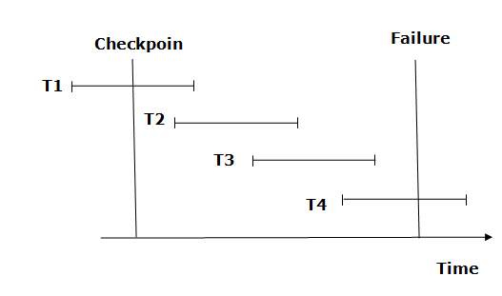
Recovery using Checkpoint
In the following manner, a recovery system recovers the database from this failure:
The recovery system reads log files from the end to start. It reads log files from T4 to T1.
Recovery system maintains two lists, a redo-list, and an undo-list.
The transaction is put into redo state if the recovery system sees a log with <Tn, Start> and <Tn, Commit> or just <Tn, Commit>. In the redo-list and their previous list, all the transactions are removed and then redone before saving their logs.

Slide 52
For example: In the log file, transaction T2 and T3 will have <Tn, Start> and <Tn, Commit>. The T1 transaction will have only <Tn, commit> in the log file. That's why the transaction is committed after the checkpoint is crossed. Hence it puts T1, T2 and T3 transaction into redo list.
The transaction is put into undo state if the recovery system sees a log with <Tn, Start> but no commit or abort log found. In the undo-list, all the transactions are undone, and their logs are removed.
For example: Transaction T4 will have <Tn, Start>. So T4 will be put into undo list since this transaction is not yet complete and failed amid.

Slide 53
The ARIES Recovery Algorithm
We now describe the ARIES algorithm as an example of a recovery algorithm used in database systems. It is used in many relational database-related products of IBM. ARIES uses a steal/no-force approach for writing, and it is based on three concepts:
write-ahead logging,
repeating history during redo, and
logging changes during undo.
the recovery mechanism must ensure that the BFIM of the data item is recorded in the appropriate log entry and that the log entry is flushed to disk before the BFIM is overwritten with the AFIM in the database on disk. This process is generally known as write-ahead logging
The second concept, repeating history, means that ARIES will retrace all actions of the database system prior to the crash to reconstruct the database state when the crash occurred. Transactions that were uncommitted at the time of the crash (active transactions) are undone.
The third concept, logging during undo, will prevent ARIES from repeating the completed undo operations if a failure occurs during recovery, which causes a restart of the recovery process.

Slide 54
Standard DBMS recovery terminology includes the terms steal/no-steal and force/no-force, which specify the rules that govern when a page from the database can be written to disk from the cache:
If a cache buffer page updated by a transaction cannot be written to disk before the transaction commits, the recovery method is called a no-steal approach. The pin-unpin bit will be used to indicate if a page cannot be written back to disk. On the other hand, if the recovery protocol allows writing an updated buffer before the transaction commits, it is called steal. Steal is used when the DBMS cache (buffer) manager needs a buffer frame for another transaction and the buffer manager replaces an existing page that had been updated but whose transaction has not committed. The no-steal rule means that UNDO will never be needed during recovery, since a committed transaction will not have any of its updates on disk before it commits.
If all pages updated by a transaction are immediately written to disk before the transaction commits, it is called a force approach. Otherwise, it is called no-force. The force rule means that REDO will never be needed during recovery, since any committed transaction will have all its updates on disk before it is committed.

Slide 55
The ARIES recovery procedure consists of three main steps:
analysis,
REDO, and
UNDO.
The analysis step identifies the dirty (updated) pages in the buffer and the set of transactions active at the time of the crash. The appropriate point in the log where the REDO operation should start is also determined.
The REDO phase actually reapplies updates from the log to the database. Generally, the REDO operation is applied only to committed transactions. However, this is not the case in ARIES. Certain information in the ARIES log will provide the start point for REDO, from which REDO operations are applied until the end of the log is reached. Additionally, information stored by ARIES and in the data pages will allow ARIES to determine whether the operation to be redone has actually been applied to the database and therefore does not need to be reapplied. Thus, only the necessary REDO operations are applied during recovery.
Finally, during the UNDO phase, the log is scanned backward and the operations of transactions that were active at the time of the crash are undone in reverse order. The information needed for ARIES to accomplish its recovery procedure includes the log, the Transaction Table, and the Dirty Page Table. Additionally, checkpointing is used. These tables are maintained by the transaction manager and written to the log during checkpointing.

Slide 56
In ARIES, every log record has an associated log sequence number (LSN) that is monotonically increasing and indicates the address of the log record on disk. Each LSN corresponds to a specific change (action) of some transaction. Also, each data page will store the LSN of the latest log record corresponding to a change for that page.

Slide 57
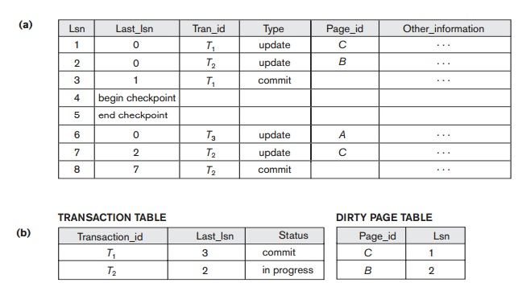
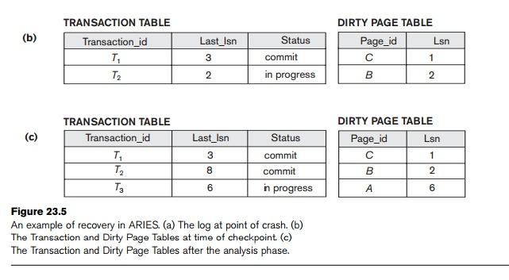
Consider the recovery example shown in Figure
There are three transactions: T₁, T₂, and T₃. T₁ updates page C, T₂ updates pages B and C, and T₃ updates page A.
(a) shows the partial contents of the log, and Figure (b) shows the contents of the Transaction Table and Dirty Page Table.

Slide 58
suppose that a crash occurs at this point. Since a checkpoint has occurred, the address of the associated begin_checkpoint record is retrieved, which is location 4
The analysis phase starts from location 4 until it reaches the end. The end_checkpoint record would contain the Transaction Table and Dirty Page Table in Figure (b), and the analysis phase will further reconstruct these tables.
When the analysis phase encounters log record 6, a new entry for transaction T₃ is made in the Transaction Table and a new entry for page A is made in the Dirty Page Table. After log record 8 is analyzed, the status of transaction T₂ is changed to committed in the Transaction Table. Figure (c) shows the two tables after the analysis phase.

Slide 59
For the REDO phase, the smallest LSN in the Dirty Page Table is 1. Hence the REDO will start at log record 1 and proceed with the REDO of updates. The LSNs {1, 2, 6, 7} corresponding to the updates for pages C, B, A, and C, respectively, are not less than the LSNs of those pages (as shown in the Dirty Page Table). So those data pages will be read again and the updates reapplied from the log (assuming the actual LSNs stored on those data pages are less then the corresponding log entry). At this point, the REDO phase is finished and the UNDO phase starts. From the Transaction Table (Figure (c)), UNDO is applied only to the active transaction T₃. The UNDO phase starts at log entry 6 (the last update for T₃) and proceeds backward in the log. The backward chain of updates for transaction T₃ (only log record 6 in this example) is followed and undone.

Slide 60
Hashing in DBMS
In a huge database structure, it is very inefficient to search all the index values and reach the desired data.
Hashing technique is used to calculate the direct location of a data record on the disk without using index structure.
In this technique, data is stored at the data blocks whose address is generated by using the hashing function. The memory location where these records are stored is known as data bucket or data blocks.
In this, a hash function can choose any of the column value to generate the address. Most of the time, the hash function uses the primary key to generate the address of the data block.
A hash function is a simple mathematical function to any complex mathematical function. We can even consider the primary key itself as the address of the data block. That means each row whose address will be the same as a primary key stored in the data block.

Slide 61
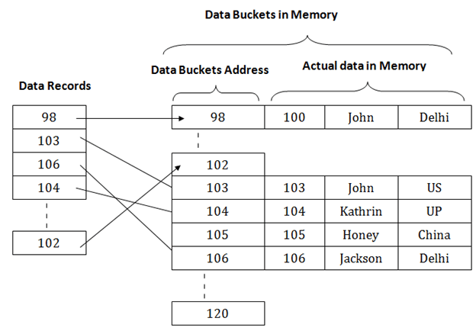
The above diagram shows data block addresses same as primary key value. This hash function can also be a simple mathematical function like exponential, mod, cos, sin, etc. Suppose we have mod (5) hash function to determine the address of the data block. In this case, it applies mod (5) hash function on the primary keys and generates 3, 3, 1, 4 and 2 respectively, and records are stored in those data block addresses.

Slide 62
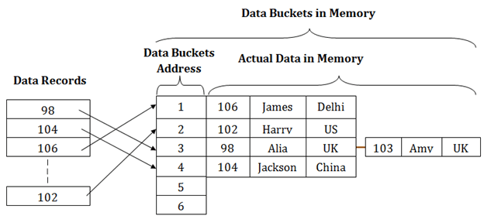

Slide 63
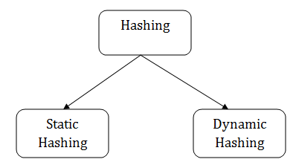
Static Hashing
In static hashing, the resultant data bucket address will always be the same. That means if we generate an address for EMP_ID =103 using the hash function mod (5) then it will always result in same bucket address 3. Here, there will be no change in the bucket address.
Hence in this static hashing, the number of data buckets in memory remains constant throughout. In this example, we will have five data buckets in the memory used to store the data.

Slide 64
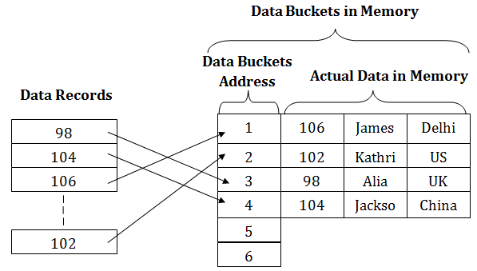

Slide 65
Operations of Static Hashing
Searching a record
When a record needs to be searched, then the same hash function retrieves the address of the bucket where the data is stored.
Insert a Record
When a new record is inserted into the table, then we will generate an address for a new record based on the hash key and record is stored in that location.
Delete a Record
To delete a record, we will first fetch the record which is supposed to be deleted. Then we will delete the records for that address in memory.
Update a Record
To update a record, we will first search it using a hash function, and then the data record is updated.

Slide 66
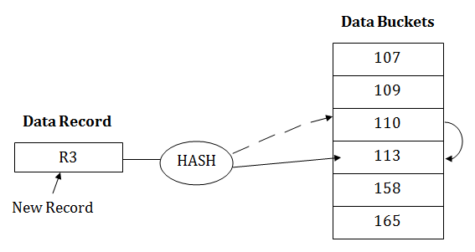
If we want to insert some new record into the file but the address of a data bucket generated by the hash function is not empty, or data already exists in that address. This situation in the static hashing is known as bucket overflow. This is a critical situation in this method.
To overcome this situation, there are various methods. Some commonly used methods are as follows:
1. Open Hashing
When a hash function generates an address at which data is already stored, then the next bucket will be allocated to it. This mechanism is called as Linear Probing.
For example: suppose R3 is a new address which needs to be inserted, the hash function generates address as 110 for R3. But the generated address is already full. So the system searches next available data bucket, 113 and assigns R3 to it.

Slide 67
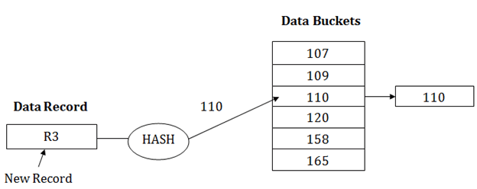
2. Close Hashing
When buckets are full, then a new data bucket is allocated for the same hash result and is linked after the previous one. This mechanism is known as Overflow chaining.
For example: Suppose R3 is a new address which needs to be inserted into the table, the hash function generates address as 110 for it. But this bucket is full to store the new data. In this case, a new bucket is inserted at the end of 110 buckets and is linked to it.

Slide 68
Dynamic Hashing
The dynamic hashing method is used to overcome the problems of static hashing like bucket overflow.
In this method, data buckets grow or shrink as the records increases or decreases. This method is also known as Extendable hashing method.
This method makes hashing dynamic, i.e., it allows insertion or deletion without resulting in poor performance.
How to search a key
First, calculate the hash address of the key.
Check how many bits are used in the directory, and these bits are called as i.
Take the least significant i bits of the hash address. This gives an index of the directory.
Now using the index, go to the directory and find bucket address where the record might be.
How to insert a new record
Firstly, you have to follow the same procedure for retrieval, ending up in some bucket.
If there is still space in that bucket, then place the record in it.
If the bucket is full, then we will split the bucket and redistribute the records.

Slide 69


For example:
Consider the following grouping of keys into buckets, depending on the prefix of their hash address:
The last two bits of 2 and 4 are 00. So it will go into bucket B0. The last two bits of 5 and 6 are 01, so it will go into bucket B1. The last two bits of 1 and 3 are 10, so it will go into bucket B2. The last two bits of 7 are 11, so it will go into B3.

Slide 70

Insert key 9 with hash address 10001 into the above structure:
Since key 9 has hash address 10001, it must go into the first bucket. But bucket B1 is full, so it will get split.
The splitting will separate 5, 9 from 6 since last three bits of 5, 9 are 001, so it will go into bucket B1, and the last three bits of 6 are 101, so it will go into bucket B5.
Keys 2 and 4 are still in B0. The record in B0 pointed by the 000 and 100 entry because last two bits of both the entry are 00.
Keys 1 and 3 are still in B2. The record in B2 pointed by the 010 and 110 entry because last two bits of both the entry are 10.
Key 7 are still in B3. The record in B3 pointed by the 111 and 011 entry because last two bits of both the entry are 11.

Slide 71
Advantages of dynamic hashing
In this method, the performance does not decrease as the data grows in the system. It simply increases the size of memory to accommodate the data.
In this method, memory is well utilized as it grows and shrinks with the data. There will not be any unused memory lying.
This method is good for the dynamic database where data grows and shrinks frequently.
Disadvantages of dynamic hashing
In this method, if the data size increases then the bucket size is also increased. These addresses of data will be maintained in the bucket address table. This is because the data address will keep changing as buckets grow and shrink. If there is a huge increase in data, maintaining the bucket address table becomes tedious.
In this case, the bucket overflow situation will also occur. But it might take little time to reach this situation than static hashing.

Slide 72
THANK YOU

